Slide 1
Newchurch to Culcheth Transition Project 2017

Slide 2
Aims
To sustain and maintain progress between KS2 and KS3
To Improve ‘Y7 readiness’
To improve attainment for Year 6 pupils (initially in Reading, Writing, Maths and Science)
To produce sustainable and exportable transition projects that can be rolled out to a range of schools in the future.
Y5-8 Curriculum

Slide 3
Success Criteria
All students make good progress, so that their levels at the end of Y7 show sustained improvement from Y6.
Y7 students have the skills required to succeed in English, maths and science at secondary school
Attainment of students in Y6 has improved in English, maths and science, particularly for More Able pupils.
Six (Three) fully resourced projects have been produced to a professional standard. They are suitable for export to a range of primary and secondary schools.

Slide 4
Project Outline
Launch meeting
Classroom visits
Work sharing and planning meetings
Completion of projects and resources with joint review
Delivery of projects
Project Showcase and Feedback
Impact review

Slide 5
English

Slide 6
Newchurch/ CHS English Presentation
By Lois, Gracie, Olivia, Anna, Will, Jack D and Jack B

Slide 7
Structure
A ‘inferring photo’ activity
Understanding what inferring is
Explained the PEA technique
Read through the first page and a half of ‘The Umbrella Man’
Finished the text in their groups with the Y8’s
Highlighted key quotes for each character
Shared ideas about quotes
Simple annotations (terminology, techniques)
Started the PEA chains
Filled in feedback ‘exit polls’

Slide 8
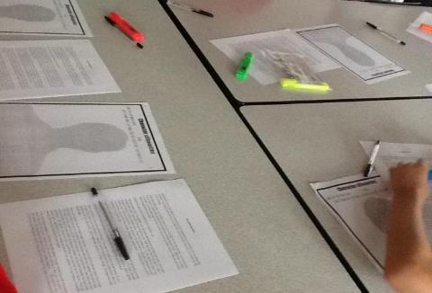
Organisation
Before the Year 6 students arrived, the Year 8 pupils were prepared by going through the Powerpoint to create a rough lesson plan.
This supported the whole group and refined the lesson because it enabled the Year 8s to assist Year 6 suitably.

Slide 9
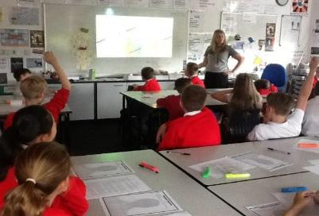
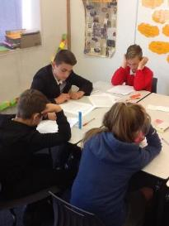
Lesson Delivery
-From the beginning, Miss described the lesson through questioning Newchurch pupils,which helped understanding and showed how to challenge their abilities while at Culcheth.
-During the first half an hour, the lesson was led by Miss, however when activities started, Year 8 scattered themselves around the room to assist and guide the Year 6s.

Slide 10
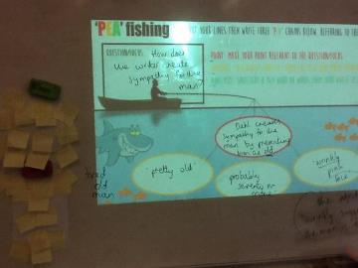
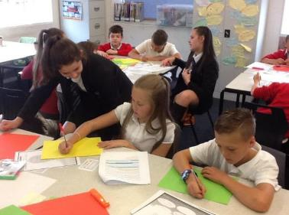
Modelling and Explaining
To present, Miss Harris started with an ‘infer the photo’; activity. This eased the Year 6s into the challenging activities to come.
Then, she showed the text and read through the first page and a half. This was a clever tactic to get the pupils to carry on reading afterward in their groups. This is where the Year 8s stepped in and began to lead their small groups.

Slide 11
Group and Independent Work
-Group work consisted of discussions, shared reading, interacting with other tables to gather quotes and creating P.E.A chains.
-The Year 6 pupils worked collaboratively with Year 8 pupils for additional support.
The Year 6 Pupils were extremely inquisitive and were eager to learn about the topic. This was shown by the amount of questions asked and the knowledgeable insights they came up with.
-They also annotated the story of ‘The Umbrella Man’ independently, however, because it was a new topic, had added support from the Year 8 students if necessary.

Slide 12
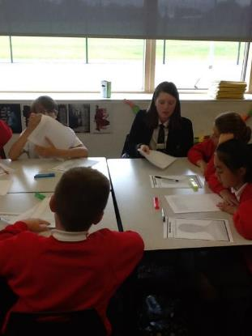
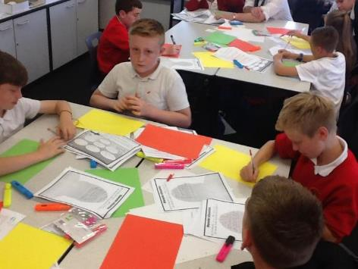
Examples of Independent and Group Work:
Year 6s working collaboratively with Year 8s.
Year 6s creating PEA chains.

Slide 13
Exit Polls
To finish the lesson, the pupils had to explain how they felt about the lesson overall. This was done by using small ‘facebook reactions’ sheets. They picked an emoji they felt represented how the lesson was and explained their answers. 100% of the exit polls were positive feedback however we did see a few that were angry. Not toward the lesson, but they were upset the man in the storyline was so manipulative which showed us they were invested in the text.

Slide 14
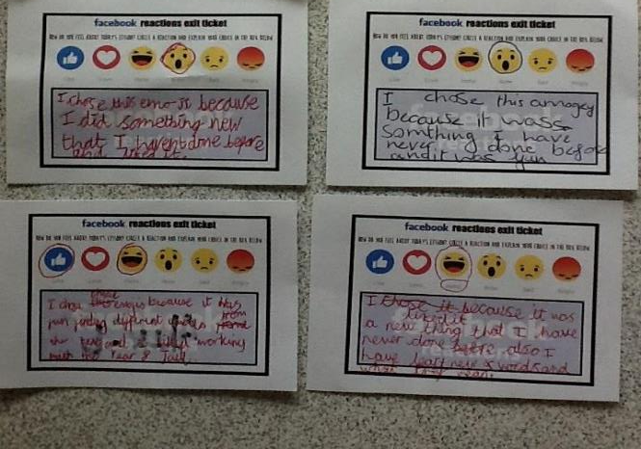
“I chose this emoji because I did something new that I haven’t done before and I liked it. - ‘wow emoji’
“I chose these emojis because it was fun finding different quotes from the text and I liked working with the Year 8 Jack.”
“I liked it because it was a new thing that I had never done before. Also, I have learnt new words and what they mean,”

Slide 15
End result...
In conclusion, the lesson received very good feedback and the students can now apply this knowledge in preparation for future studies at Culcheth High School. Being introduced to high school techniques before they join helps their transition into High school and benefits them in the long run.
In addition to this, the project benefited the year 8’s. By doing it, the year 8’s gained vital skills like confidence and presentation skills. Also, because they lead small groups and activities it gave the year 8’s responsibility which may help them with future jobs and careers.

Slide 16
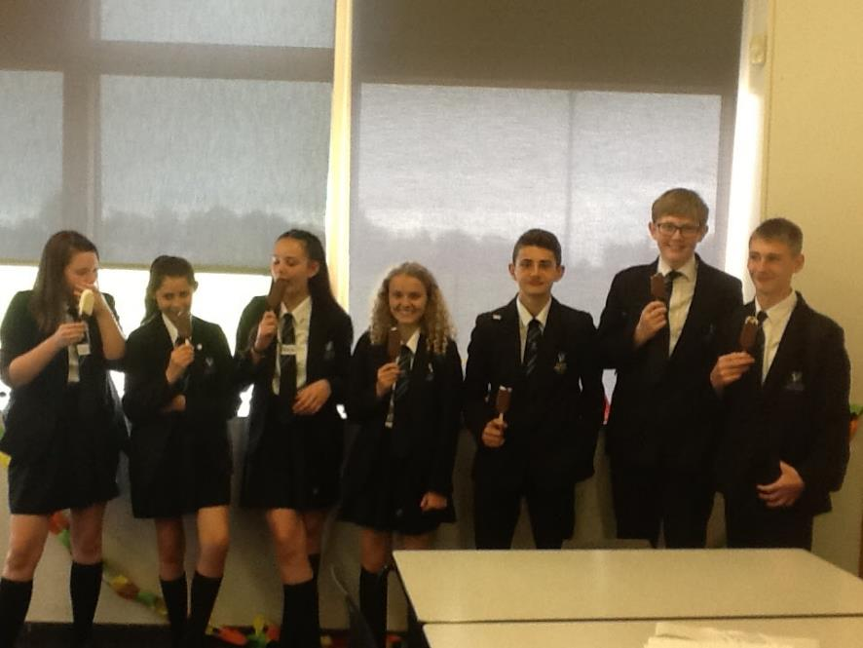
P.s Thanks for the ice-cream!

Slide 17
Maths
Mr Duckett and Mr Barry

Slide 18
Theme: Maps
The aim was to build on some work that Year 6 had been doing based on maps, and to see the connections between mathematical topics.
This is important as at GCSE there is an increased emphasis on problem solving and bringing together topics which might not appear to be obviously linked.

Slide 19
Starter: Networks and nodes
This was an activity where the students had to replicate shapes without lifting the pen or going over lines twice.
We started with the classic
and got progressively tougher

Slide 20
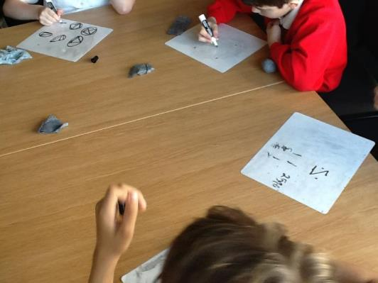
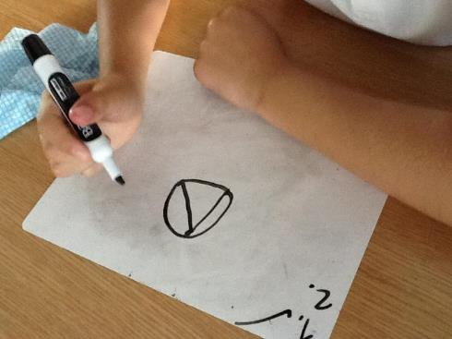
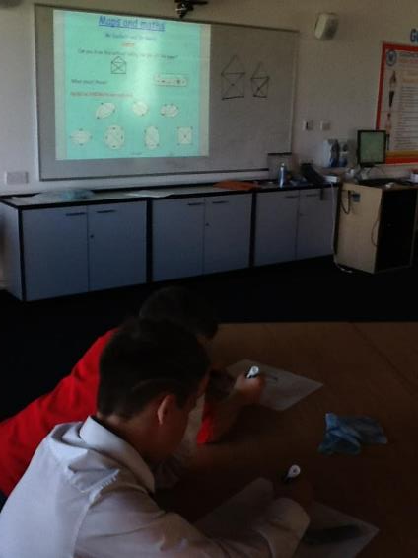

Slide 21
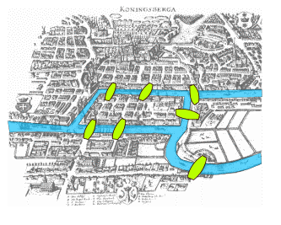
We then had a quick chat about the ‘Bridges of Koningsberg’ problem, but they didn’t have to solve it as that requires degree level maths (and it’s impossible)!

Slide 22
Digimaps
We then headed to a computer suite to work on a great site called Digimaps.
Mr Duckett showed us the key features of Digimaps, and this allowed us to measure distances, plot routes, find places we knew and look at catchment areas of schools.

Slide 23
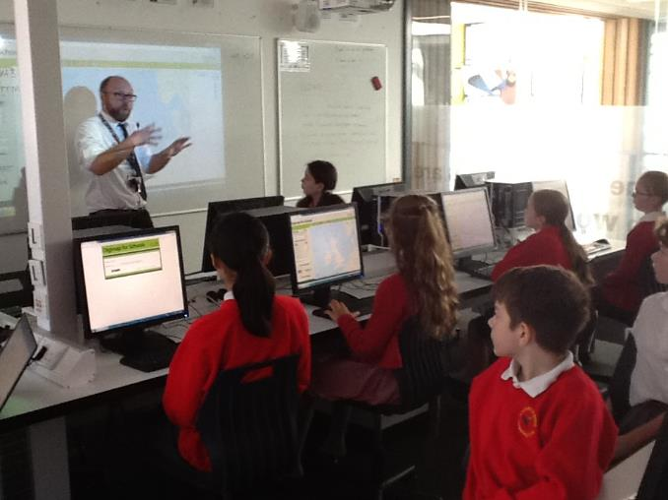
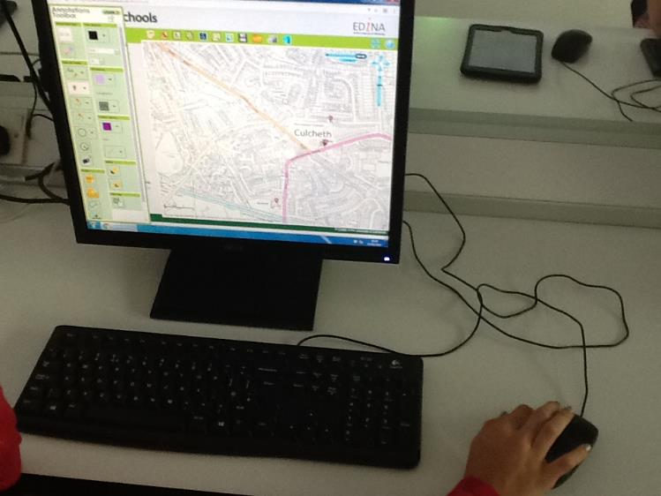

Slide 24
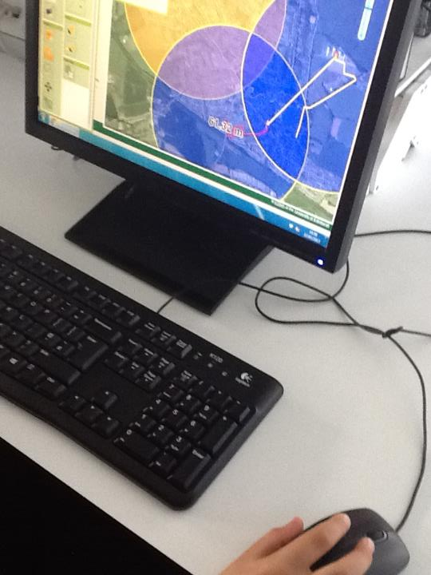
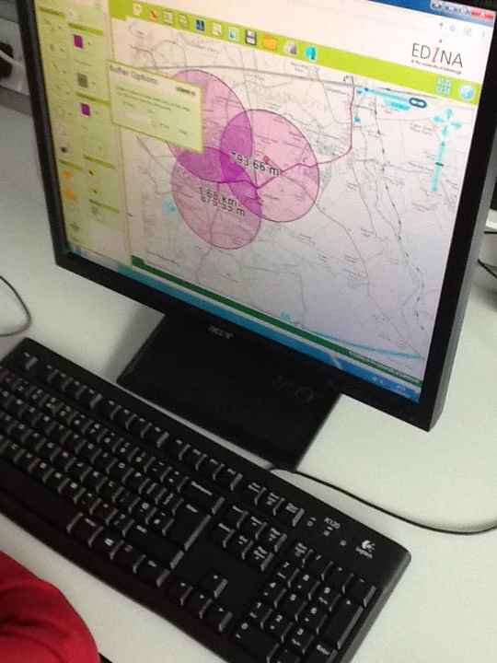

Slide 25
Tube Map
After a short break we looked at the links between areas of maths, and how some topics could appear in more than one strand, such as fractions appearing in both Number and Algebra.
The students worked in groups to populate a blank tube map.

Slide 26
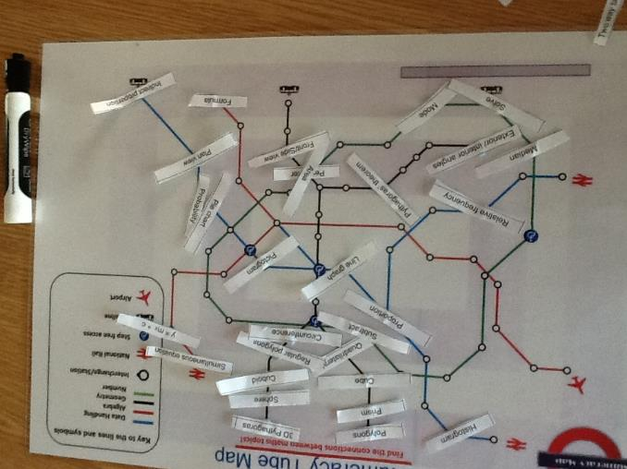
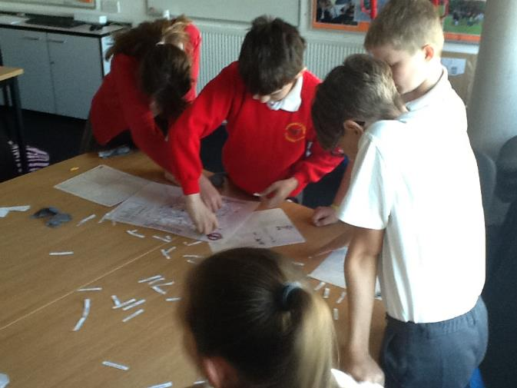

Slide 27
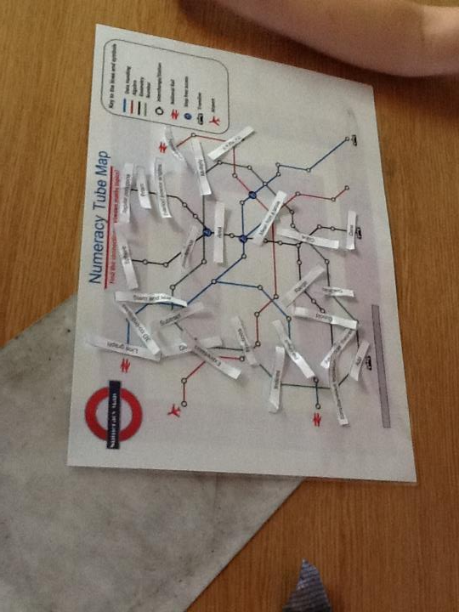
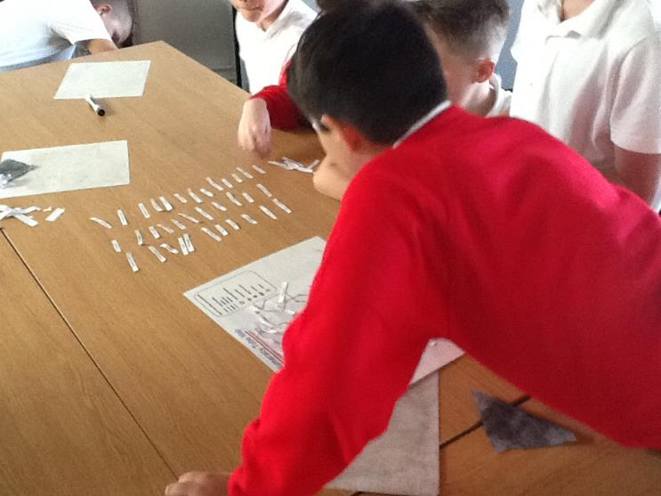

Slide 28
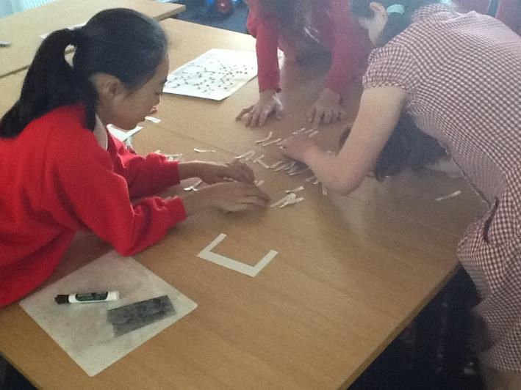
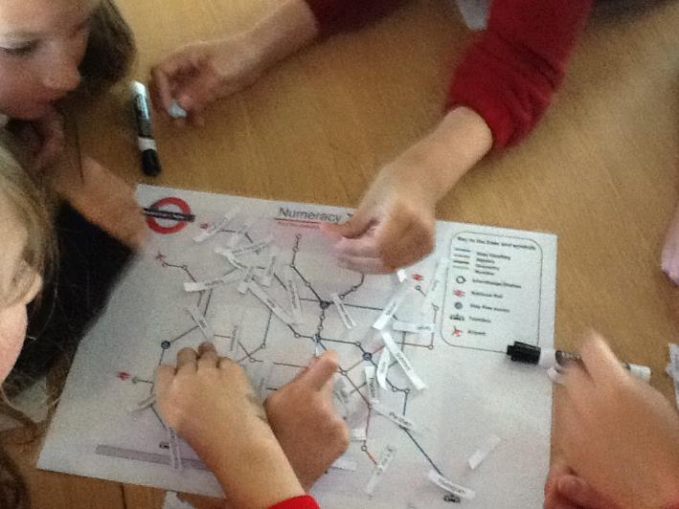

Slide 29
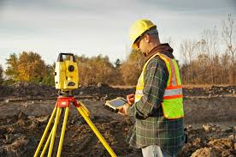
Clinometers
Next it was time for some cutting, sticking, and practical maths.
We followed Mr Barry’s instructions and used protractors, string, straws and tape to make a measuring tool called a clinometer. These are basic versions of theodolites – these days more commonly called total stations (the yellow tripods we often see at the side of roads)

Slide 30
Clinometers
We then used the clinometers to measure the difference in the angles between the base and top of the television mast on Winter Hill, which we would need later…

Slide 31
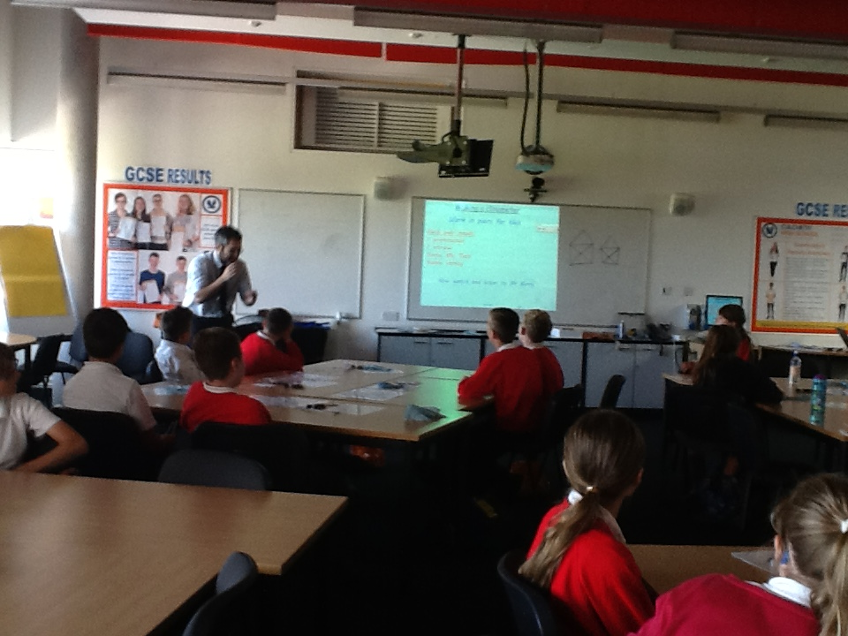
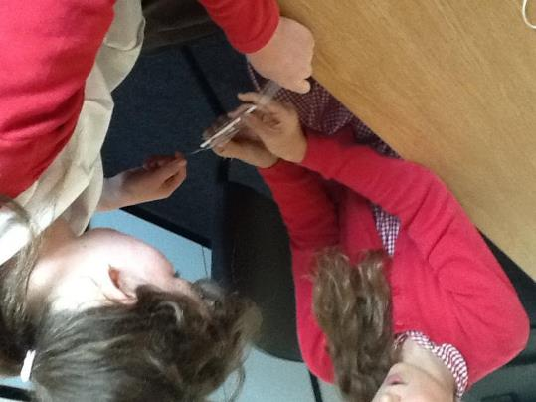
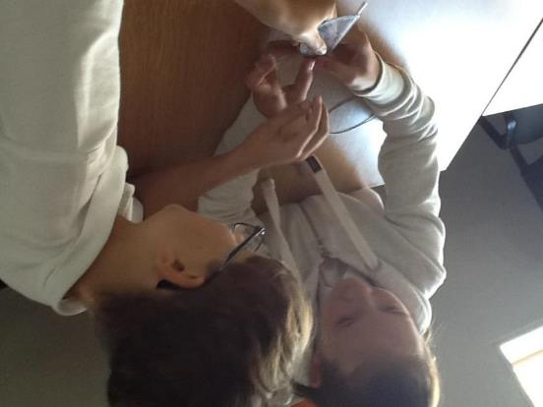

Slide 32
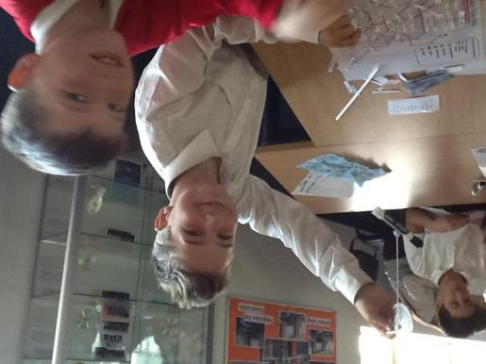
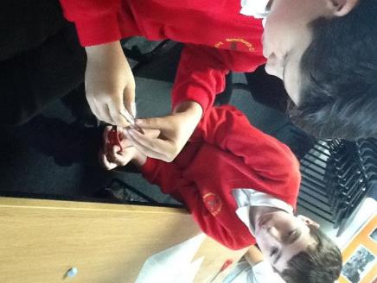
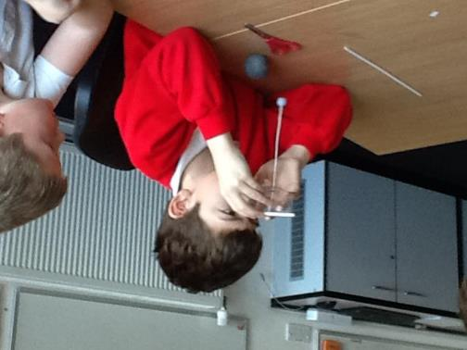
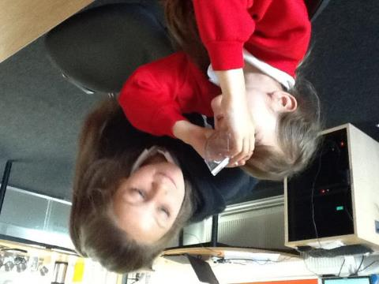

Slide 33
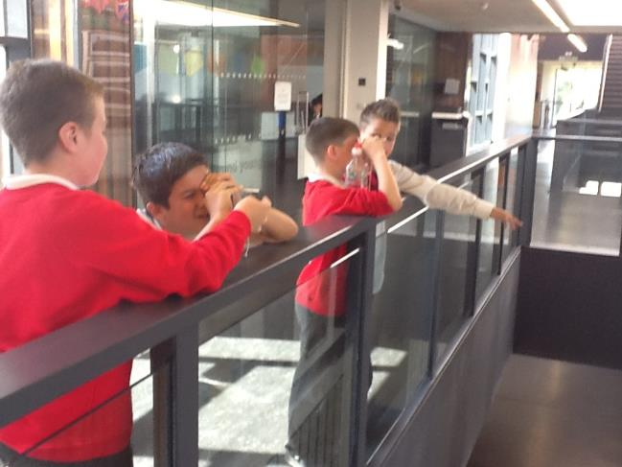
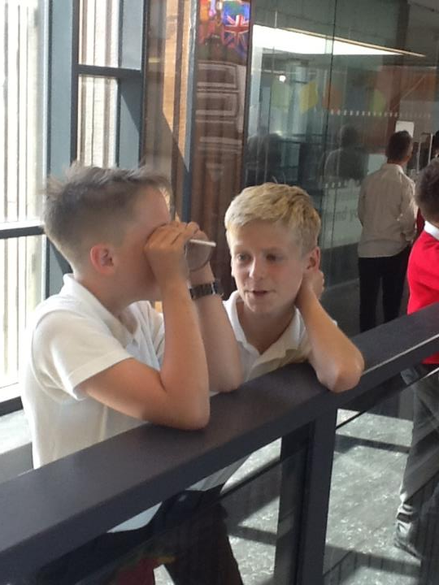
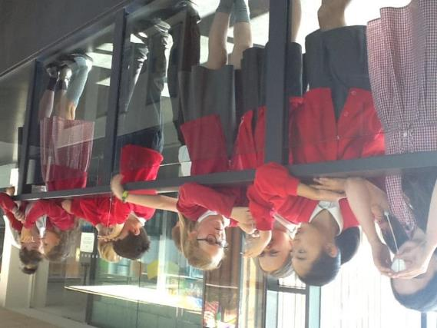

Slide 34
Digimaps 2
We returned to the computers to find the distances between some key points in Culcheth (the library, CHS, Newchurch, the parish church, Twiss Green and Mr Duckett insisted on the Cherry Tree…). We made distance charts which we would need later.
We also tried to work out where in the school we had taken our clinometer readings, and measured the distance from there to Winter Hill.

Slide 35
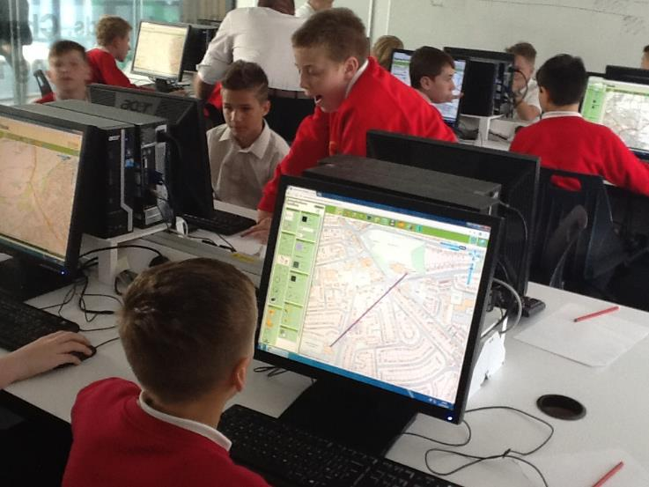
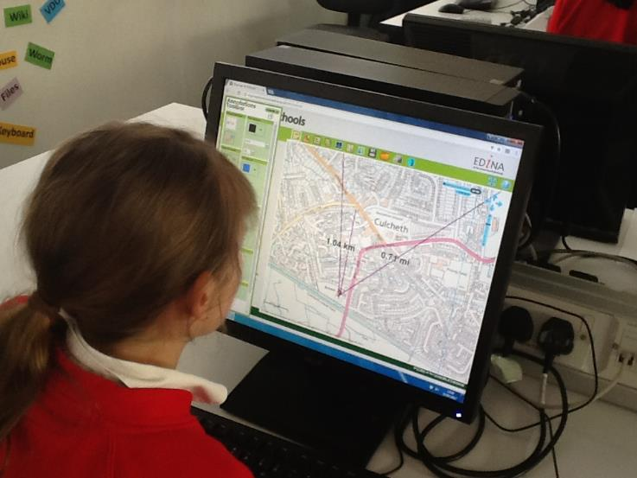

Slide 36
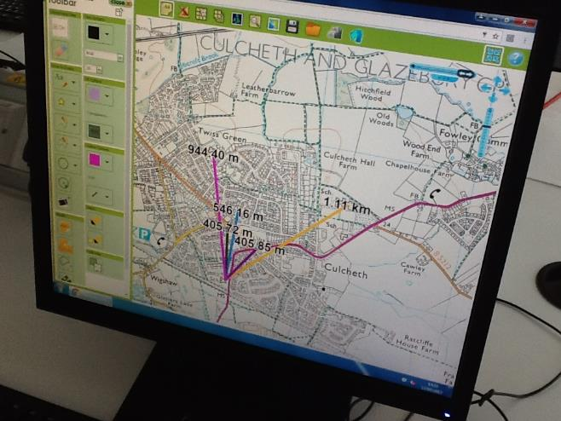
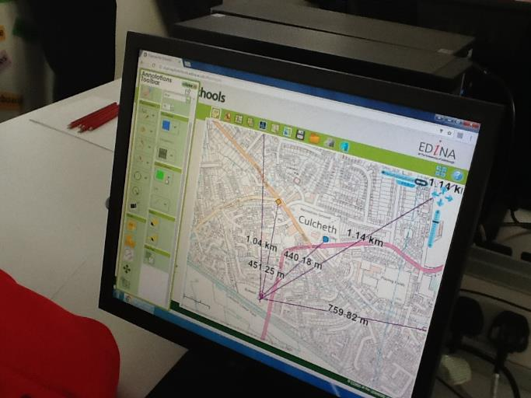

Slide 37
Trigonometry
Mr Barry introduced us to some new buttons on the high school calculators (sin, cos and tan) and showed us how to use the angle and distance to calculate a height. This is a grade A/7 topic!!
The mast is actually 309m tall, and one group got really close (270m), so they must have made a great clinometer!

Slide 38
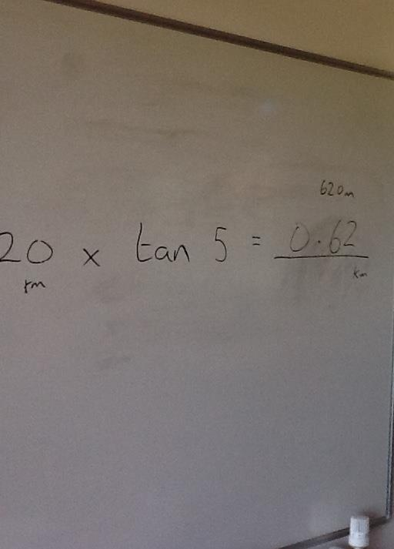
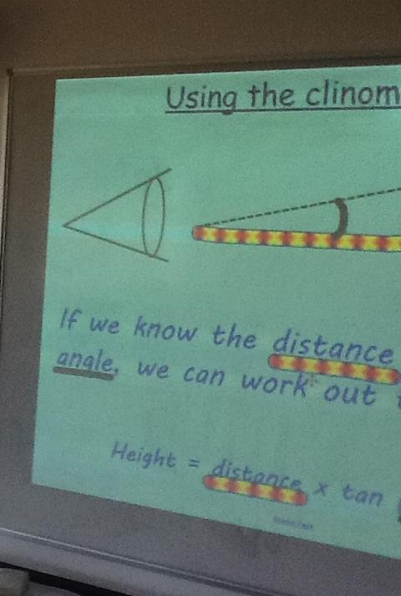
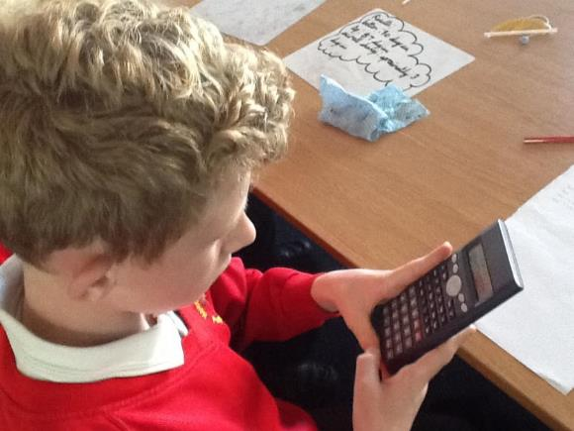

Slide 39
Scale
After some much needed food (and about a dozen oranges) we discussed maps and scale, and how to convert measurements.
We then headed outside to the astro to make scale maps of Culcheth using the data we collected earlier.
The original plan was to make nets of shapes, but unfortunately it was a bit too windy! We used trundle wheels to measure the distances, with whiteboards and in some cases ourselves used to represent the landmarks.

Slide 40
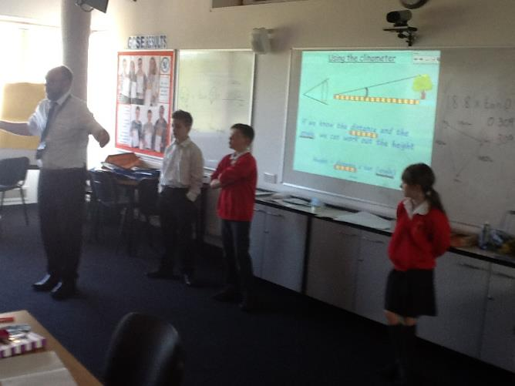
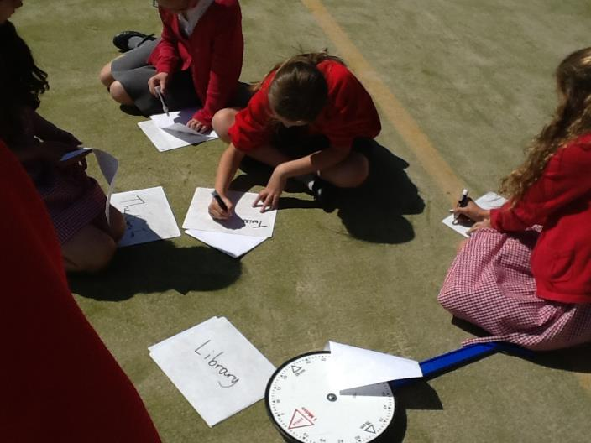

Slide 41
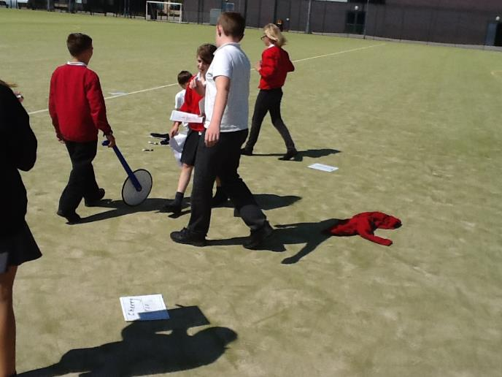
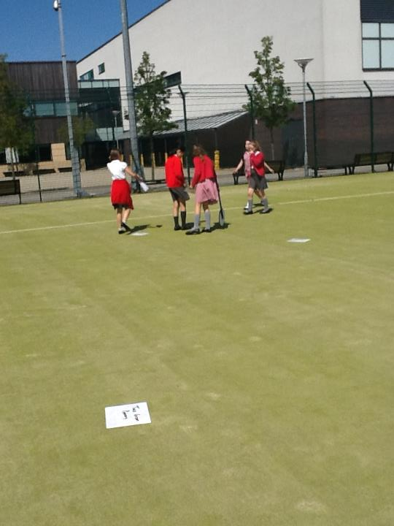

Slide 42
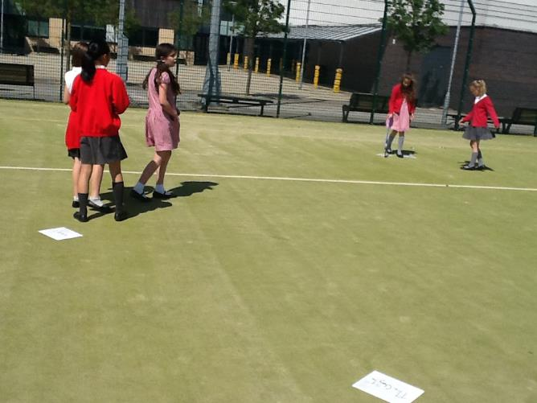
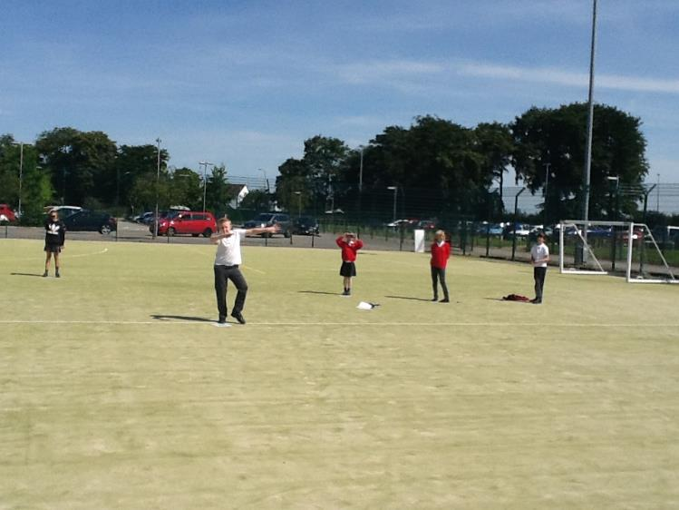

Slide 43
Pupil Conferencing
I enjoyed doing Digimaps - it was awesome. - Jamie
I had an amazing time building clinometers and doing Digimaps – exploring Culcheth. - Alfie
The maths was really fun and engaging because we got to use new resources. - Nathan
I enjoyed the high school maths so much I can’t wait to come to Culcheth High School. - Sophie
I really enjoyed the maths day because it was a new experience. I liked it because we learnt about clinometers which we had never learned before and worked on computing and maths together which is always fun. – Jazmin
I really loved the lesson at high school, due to the fact it was very engaging, practical and fun. My favourite part was Digimaps – getting the measurements. – Ben C
Maths with Mr. Barry was fun especially doing the work with the clinometers. - Jakub
It was exciting to start taking maths to the next level and I enjoyed the hands on work when we made clinometers. - Alex
I really enjoyed working as a partner/team. It was the first time I learnt about clinometers; it was really interesting. - Natsuki

Slide 44
Reflections
What went well
Engagement
Links between topics
Practical
Exposure to KS3/4 Maths
To build upon next time
Timings of activities
Position in calendar

Slide 45
Science

Slide 46
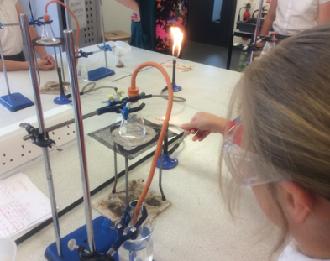
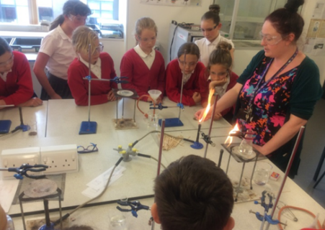
Science Transition Project

Slide 47
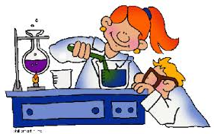
Lesson Observations in Different Settings
After the initial meeting, the Science Co-ordinator at Newchurch CP School and Science teacher at Culcheth High School arranged lesson observations in one another’s settings.
Notes:
The purpose of this was to explore the similarities and differences between Science teaching and learning at Primary and Secondary level.
This was a very useful process and provided the leaders with an insight into the needs of the pupils as they go through the transition between Science at Primary School and Secondary School.
At this point, we were able to establish the key differences in Science teaching at Primary and Secondary level.

Slide 48
Planning Meetings
Barriers children face at the start of Key Stage Three:
Use of equipment
Writing up investigations
Independence and safety around the Science laboratories
Barriers at the end of Key Stage Two:
Lack of opportunity for Chemistry and the focus in Upper Key Stage Two seeming to be Physics and Biology based due to the restraints of the National Curriculum.
Lack of resources
Notes:
We explored and discussed the main issues and barriers that face the children when they begin at Key Stage Three and many issues were discussed including
use of equipment
writing up investigations
children’s independence and safety around the Science Laboratories.
As well as this, we looked at the curriculum at Key Stage Two and the lack of opportunity for Chemistry and the focus in Upper Key Stage Two seeming to be Physics and Biology based due to the restraints of the National Curriculum. We also discussed the lack of resources in Primary School settings and how this can sometimes impact the teaching and learning that takes place in Science, as well as lack of confidence and perhaps subject knowledge for teachers.

Slide 49
Pupil Voice
Additionally, we discussed the fact that pupil voice has shown us at Newchurch that pupils want to ‘become proper scientists’ and experimenting in laboratories with lab coats and goggles is how they imagined this.

Slide 50
Our Aim
From this, we decided:
To plan a transition project towards the end of the academic year in the form of a Science Week.
To create resources and lesson plans that could be used by both teachers in both Primary and Secondary setting.
The focus would be on chemistry skills
They would get the opportunity to use Science equipment and learn how to use it safely.
They would visit the Science laboratories at Culcheth High School to become ‘real scientists’
They would focus on skills related to scientific enquiry such as writing up experiments, choosing and using equipment and developing independence.
Notes:
From these findings, we decided on our future actions for this project. We felt that Year 6 children would benefit from a transition project towards the end of the academic year in the form of a Science week.
From what we discovered, we felt it very important that the pupils have chance to focus on chemistry skills; use equipment and visit science laboratories at the Secondary School and use resources created by the High School so that transition will be easier for these pupils.
We agreed that each day of the week should have a specific focus, identified by the Secondary School as the barriers for the children as they begin in Year 7 e.g. writing up methods and investigations, using equipment, safety and plans are resources will be created by Science leaders.

Slide 51
Notes:
You will see from the planning and resource samples on your table that the lessons were planned with great though and collaboration between Primary and Secondary leads to ensure that they were exciting and inspiring.
We made sure that there were a mix of lessons to suit different ;earning styles.
Each lesson had a clear objective to meet our aims e.g. writing up investigation, use equipment safely.
The lessons started at a basic level e.g. naming equipment in matching activities and learning the hazard signs and safety rules of a Secondary School laboratory. The lessons then led to more practical investigations involving real life problems and contexts. During these lessons, the children were given the opportunity to use the equipment, work scientifically and learn how to use the lab independently and safely.
Resources were brought from Culcheth to Newchurch to support the lessons that took place in the Primary setting.

Slide 52
Photos of the week
Notes:
The week was very successful. The children particularly got a lot from visiting the High School and one child said ‘he didn’t want to leave’ They learnt names of equipment that they had never seen before e.g. bunsen burners, tripods and more importantly, by the end of the week, they were able to use this equipment safely.
The real life problems that provided the context for the experiments meant that the children felt their was a purpose to their science work and one quoted that it was ‘interesting and intriguing’
Children produced some good written work at the end of it demonstrating the impact.
Teachers commented on how well it went and how the children would not have been able to have had this experience without the use of the equipment, resources and lab. Parents have even commented that they are impressed with the amount of transition opportunities that the children have been provided with.

Slide 53
Notes:
The children now have the confidence to work scientifically in a lab and have developed some independence that can be built on when they go into Year 7. They also know how to use some of the equipment safely and hazards associated with it. This would have usually taken place at the start of KS3 but having already done this, no teaching and learning time will be wasted at the start of Year 7.

Slide 56
Pupil Voice

Slide 57
Teacher Feedback
’I have really enjoyed being part of the transition project. The pupils have demonstrated some excellent investigation skills and also developed their planning techniques. They also now know the names of the different pieces of equipment that we use in the lab. This gives them a great start to Y7!’ – Louise Birchall, Culcheth High School.
‘The transition for Science was exceptionally useful. Y6 revelled in using KS3 equipment and experiencing the laboratories. Dr Birchall challenged Y6 brilliantly; it was great to see them proving how adept they are in the Sciences.’ – John Duckett, Newchurch Primary School.

Slide 58
“I really enjoyed the English because of the structure and choice of text. I liked finding key information such as quotes and inferring things.”
“I really enjoyed working in a team with Year 8.”
“It was a fun lesson and I can't wait for high school now.”
“The English we did was great fun and very engaging.”

Slide 59
Notes:
Based on the success of this year, we would like to continue to develop the transition of the core subjects this year so that it each year children are equipped with the relevant understanding of what Y7 has to hold. Although this project has been very successful and the children have loved it and state that they feel very prepared for high school, timetabling for this with three subjects has been difficult with just one Y6 class and class teacher.
Next steps would be to perhaps look at transition rolling out at different points throughout the academic year or Y7 teachers coming into Newchurch.
We also want to role it out to other feeder primaries but may be worth trialling the different organisation to see if it works before doing that.

Slide 60
Notes:
Next year we would like to develop transition projects in History, Geography and MFL. Perhaps that we look at planning together with the Y5 – Y8 curriculum in mind.
More team teaching and support at the planning and teaching stage to extend the children during their topic work in these areas using CHS teachers specialism to improve outcomes throughout the school as well as ensure transition into Y7.

Slide 61
Any Questions?

