Slide 1
Mathematic Workshop 2016 Arithmetic and Reasoning Key Stage One

Slide 2
Aims for the session:
To explain the expectations of the Mathematics curriculum.
To explain how Mathematics is delivered in school.
To provide some guidance on supporting your children at home.

Slide 3
Aims of the Mathematics curriculum
The national curriculum for mathematics aims to ensure that all pupils:
become fluent in the fundamentals of mathematics, including through varied and frequent practice with increasingly complex problems over time, so that pupils develop conceptual understanding and the ability to recall and apply knowledge rapidly and accurately
reason mathematically by following a line of enquiry, conjecturing relationships and generalisations, and developing an argument, justification or proof using mathematical language
can solve problems by applying their mathematics to a variety of routine and non-routine problems with increasing sophistication, including breaking down problems into a series of simpler steps and persevering in seeking solutions

Slide 4
What does this mean in reality?
Children will have the chance to EXPLORE ways of finding an answer and will be confident in explaining their methodology and how it works.
They will have mastered the KEY SKILLS needed to solve problems in abstract and real world forms.
The children will have the opportunities to APPLY their knowledge in practical and cross curricular scenarios.

Slide 5
Fluency, Reasoning and Problem Solving

Slide 6
Maths: SATs
SATs test will take place at the end of Y2 (KS1) and at the end of Y6 (KS2)
KS1
There will be two tests:
Mental Arithmetic (20 mins)
Mathematical fluency and reasoning (35 mins)

Slide 7
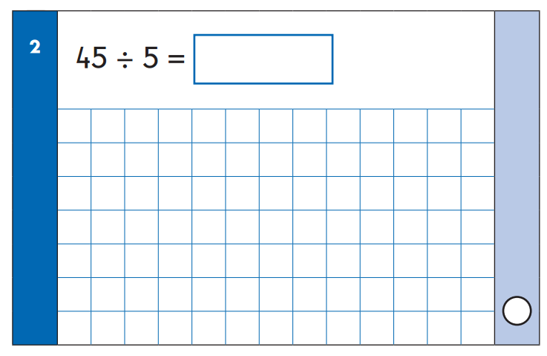
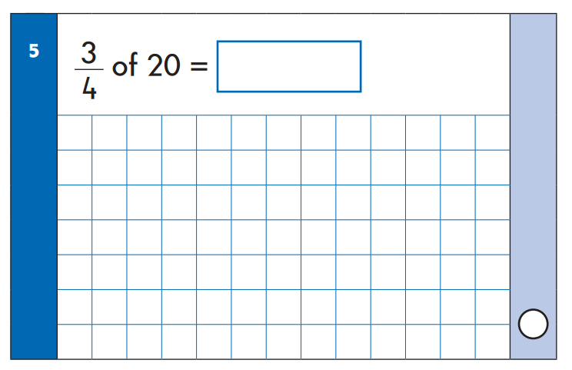
Maths: KS1 SATs
Examples from the Mental Arithmetic Sample Paper

Slide 8
Maths: KS1 SATs
Examples from the Fluency & Reasoning Sample Paper

Slide 9
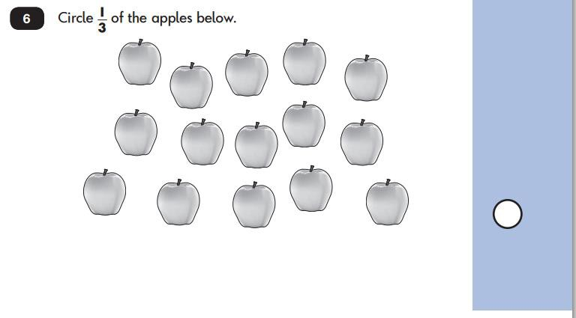
Maths: KS1 SATs
Examples from the Fluency & Reasoning Sample Paper

Slide 10
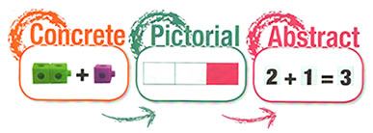

Slide 11
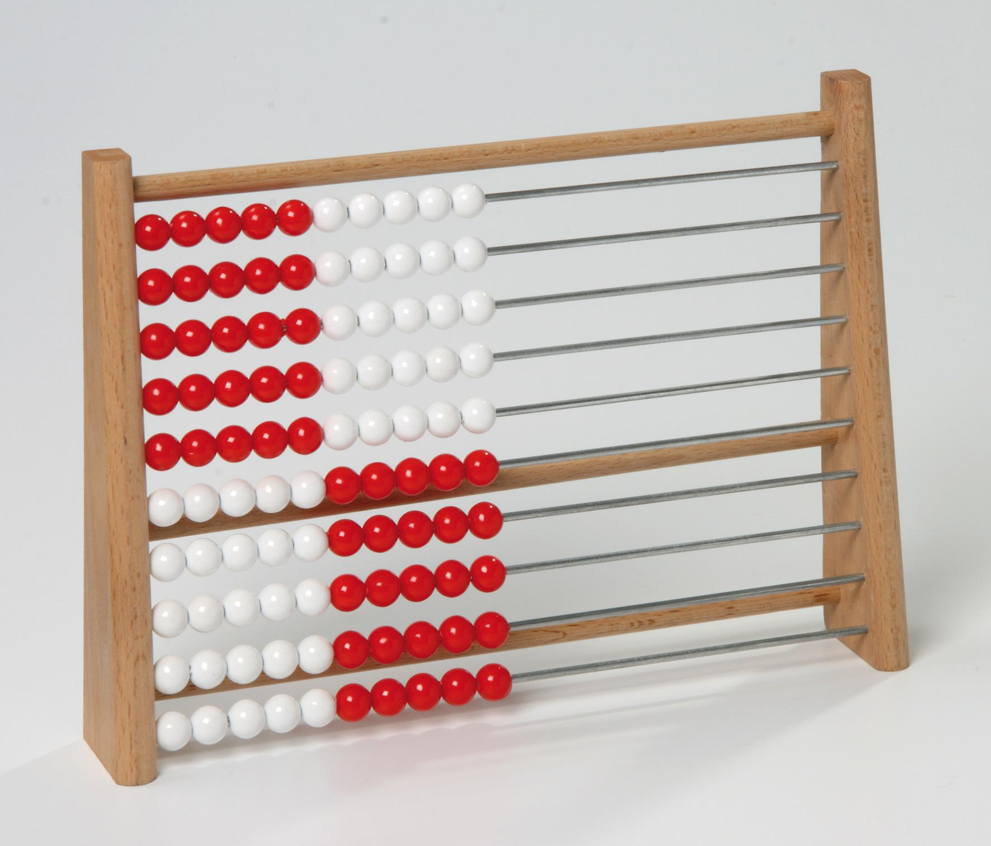
Early Years and Key Stage One
The focus is on mental arithmetic using concrete and pictorial forms. These practical activities will give children a sense of number e.g. the ‘nine-ness’ of nine.

Slide 16
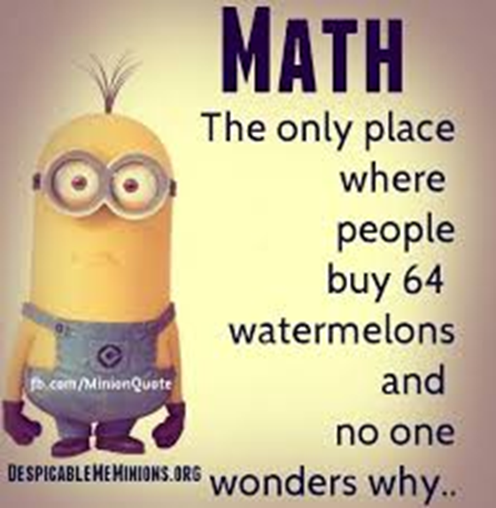
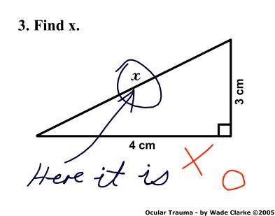
Preconception and Misconception
‘Don’t worry…I was never very good at maths either’
‘The maths they learn now won’t be needed when they finish school anyway.’
‘We weren’t taught it like that and our maths is ok.’
‘Why would an n year old need to know that?’
‘Why is knowing what a tetrahedron is useful?’
‘I want to help with homework but they do it differently.’
‘I don’t want to confuse them.’
‘I just don’t feel confident with maths.’

Slide 17
Tables, Tables, Tables
Year One = x2, x5 and x10
Year Two = x2, x3, x5 and x10

Slide 18
Counting Ideas
Practise chanting the number names. Encourage your child to join in with you. When they are confident, try starting from different numbers.
Make mistakes when chanting. Can they spot your error and correct you?
Give your child the opportunity to count a range of objects (coins, pasta, buttons, mixed objects.) Encourage them to touch the objects and move them as they count.
Count things you cannot touch to make it more difficult (passing cars, ceiling lights etc.)
Play games that involve counting (e.g. snake and ladders, cards, dice.)
Look for numerals in the environment – at home, in the street, when shopping.
Cut numbers out of magazines and try to order them.
Choose a number of the week and practise partitioning it, building it, counting in steps of the number.
Use counting apps on tablets, phones and computers.

Slide 19
Working With Number Facts
Have a ‘Fact of the day’. This could be written on a whiteboard. Ask your child to recall the fact during the day. Occasionally put false facts up for them to spot.
Play games which involve score keeping. Try to include the steps linked to the tables e.g. ‘If you hit red it is one point, green is two, blue is five’. Darts and cards can be very useful.
Use manipulatives such as counters and dice. Challenge children to count things with a time limit, encourage grouping.
Work backwards – give them an answer and see if they can build possible questions.
Build on known facts e.g. ‘If 3 + 5 = 8, what else can we say?’ (5 + 3 = 8, 8 – 5 = 3 and 8 – 3 = 5).

Slide 20
Shapes and Measures
Choose a shape of the week e.g. cylinder or sphere to look out for. Ask the child to describe it using key vocabulary e.g. vertices (corners).
Play guess my shape. You think of a shape and describe its features for the child to guess. Allow them to think of a shape for you to guess.
Look for symmetry in the world around them.
Draw and paint shapes, or pictures using shapes. Cut out shapes to manipulate.
Allow your child into the kitchen when measuring for cooking or using timers. Discuss how measures are divided e.g. scales.
Order objects by weight, length, time etc.
Allow the child to use a stopwatch to time games e.g. How quickly can mum write every letter of the alphabet? How quickly can Dad run round the garden?
Use calendars and use the range of vocabulary linked to time (e.g. yesterday, tomorrow, days of the week, months of the year.)

Slide 21
Visual Calculation and Visual Fractions Policies

Slide 22
Interim Framework

Slide 23
RAPACODANUMBO

Slide 24
How Much Should I do At Home?
Focusing on your child’s mental maths can help to support the written methods they may use within school.
Focus on counting (forwards and backwards) and NOT always from 0! Remember, fluency and being able to apply is key.
E.g. add 3 each time. Let’s start from 28, 31, 34, 37, ?, 43, ?, 49
What numbers are missing? How do you know?
Focus on place value (what each digit really represents).
E.g. How many tens does 32 have?
How many more units does 46 have than 42? How do you know?
Draw me number 32 and 23. How are they different? Which is biggest? Why?

Slide 25
Apply maths to real life where possible:
E.g. This tin of beans costs 19p and this one costs 23p.
Which is the most expensive? How do you know?
How many more pennies do I need to buy this packet of biscuits if I only have 5p?
I have picked up 3 apples. How many more do we need so that we have 10?
Ask children to count as they pick them up and put them into the bag.
Using 10p pieces and 1p pieces can be great for place value.
Show me 23p using these coins.

Slide 26
What is FLUENCY?
EFFICIENCY
Students select an efficient strategy to solve a problem e.g. knowledge of number facts rather than counting objects to solve 16 + 2.
ACCURACY
Careful recording, knowledge of number facts and relationships, double checking answers e.g. 11 + 4 = 51
FLEXIBILITY
Use of more than one approach to solve a problem e.g. one strategy to solve and another to check e.g. check that 16 + 2 = 18 using the inverse 18 – 2 = 16

Slide 27
What is REASONING?
Reasoning is where we use what we know to work out things that we don’t
e.g. 2, 4, 6, …, 10
Research suggests that the ability to reason is the most important skill in ensuring that a child is mathematically successful.
Encourage you child to:
Describe what they did.
Explain how they go their answer.
Convince you or prove their answer is correct.
e.g. I know……because……
The answer cannot be……because……
When I tried…..I noticed……
If this is true then……

Slide 28
What is PROBLEM SOLVING
Problem Solving is important as children need chance to apply skills and knowledge in real life and open ended situations.
To solve problems children need to:
Select relevant information
Decide which operation and calculation to use
Decide on an efficient method
Calculate accurately
Check answers and work in context
Consider how to organise their thinking
Consider where and how to start
Children need to be secure with problem solving at their level before moving to more complex challenges. Fluency is not enough.

Slide 29
Arithmetic Paper
ADDITION
Bridging through ten e.g. 23 + 18
1 digit and 2 digit
Adding three integers e.g. 7 + 12 + 13
Missing values (variables) e.g. 14 + □ = 23
SUBTRACTION
1 digit and 2 digit
Bridging 10 e.g. 23 – 11
Missing box e.g. 23 - □ = 14
MULTIPLICATION
1 digit multiplication e.g. 3 x 3 = …, 5 x 0 = …, 8 x 10 = …
DIVISION
Dividing by 2, 3, 5 and 10 e.g. 12 ÷ 2 = …, 35 ÷ 5 = …
Fractions 1/3 of 21 = …, ¾ of 40 = …

Slide 30
Reasoning Paper

Slide 31
Reasoning Challenges

Slide 32
People and fish
Dogs and fish
People, cats and fish
3
1
2
24 eyes,
28 legs and
8 tails
20 eyes
& 14 legs
20 eyes
& 32 legs
People and dogs
People and octopi
4
5
28 eyes & 36 legs
24 eyes & 72 legs

Slide 33
Using Accurate Vocabulary

Slide 34
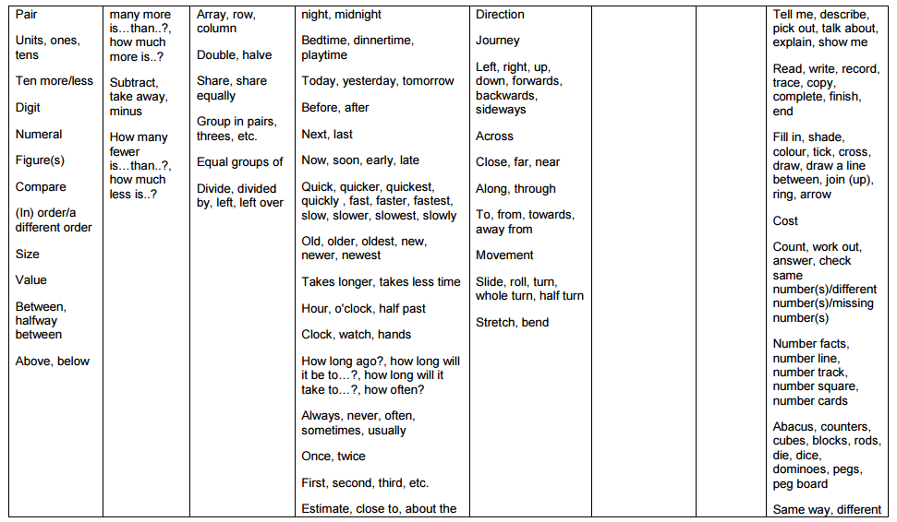

Slide 36
Progression in reasoning (Nrich)
Describe – say what you see, hear or do
Explain – offer some reasons for above
Convince – yourself or a friend that you have a solution or case
Justify – say why you are convinced
Prove – to others with a ‘watertight’ argument including when challenged!

Slide 37
Sometimes, Always, Never?
Any number times 0 equals 0.
Any number times 1 equals 1.
Any number times 10 will end in a zero.
Any number times 5 will end in a zero.
Any number times 0.5 will equal half of itself.

Slide 39
Here’s the Answer, what’s the Question?
12 is the answer.
What is the question?

Slide 40
Bar Model Mathematics

