Slide 1
Newchurch Primary Residential Consultation Evening
Meeting the need of our children and preparing them to fly

Slide 2
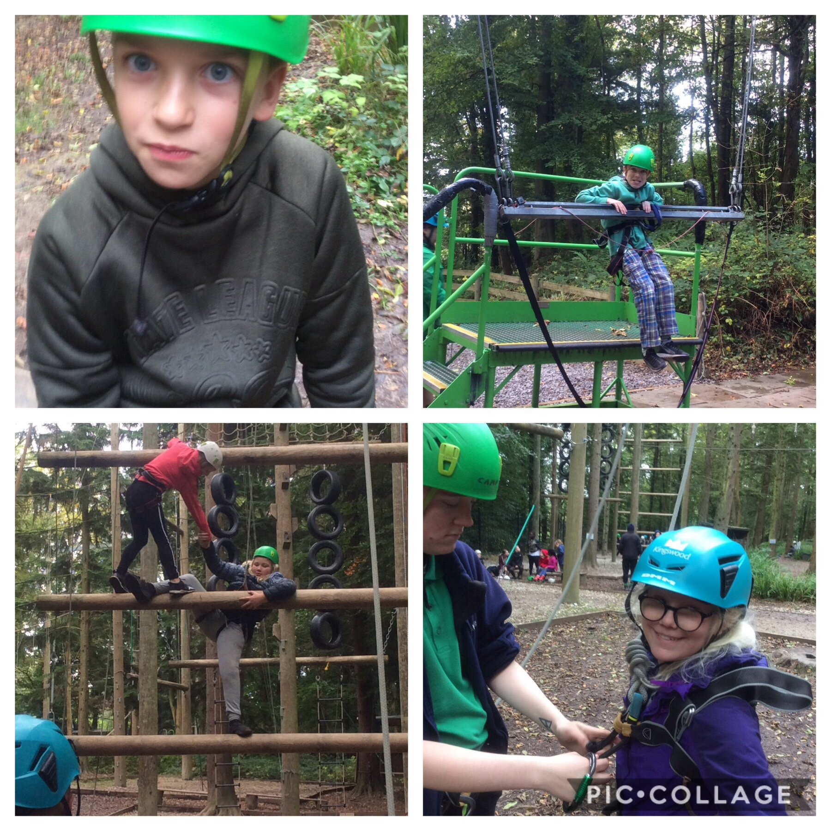
Rationale
Reasons for change
Meeting the demands of the national curriculum
Developing independence
Enriching the curriculum
Presenting challenge

Slide 3
Timescale, costing and ratios
Centre | Timescale | Costing | Ratio
Beeston Outdoor Education Centre, Tarporley, Cheshire | 1 night (May 2021) | £60.50 | 5 staff members (1:6)
Kingswood Education Centre, Colomendy, Wales | 2 nights (October 2020) | £159 | 4 staff members (1:10)
Arete Outdoor Centre, Caenarfon, Wales | 4 nights (October 2020) | £260 | 4 staff members (1:15)
All trips will include a member of the senior leadership team and a trained first aider.

Slide 4
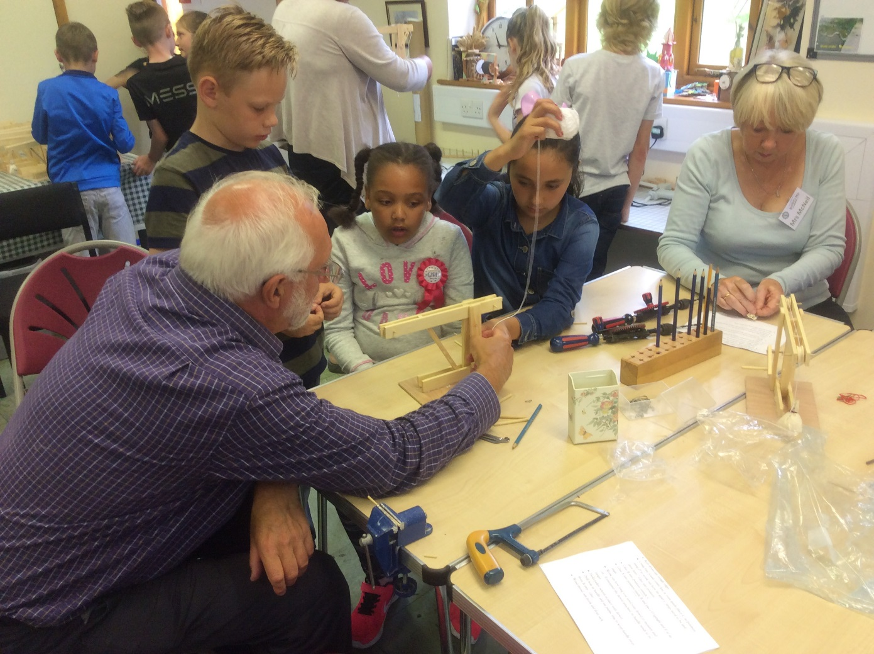
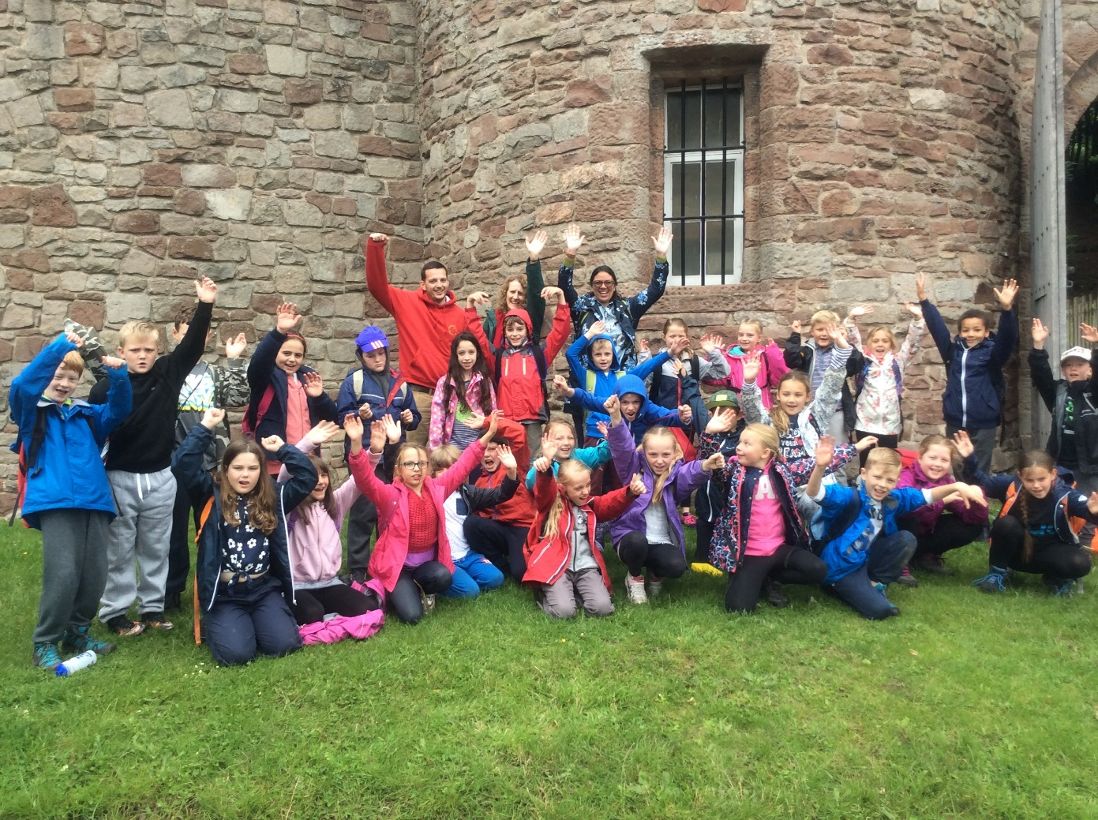
Beeston Outdoor Education Centre
History
The national curriculum for history aims to ensure that all pupils:
know and understand the history of these islands as a coherent, chronological narrative, from the earliest times to the present day: how people’s lives have shaped this nation and how Britain has influenced and been influenced by the wider world
gain and deploy a historically grounded understanding of abstract terms such as ‘empire’, ‘civilisation’, ‘parliament’ and ‘peasantry’
understand historical concepts such as continuity and change, cause and consequence, similarity, difference and significance, and use them to make connections, draw contrasts, analyse trends, frame historically-valid questions and create their own structured accounts, including written narratives and analyses
understand the methods of historical enquiry, including how evidence is used rigorously to make historical claims, and discern how and why contrasting arguments and interpretations of the past have been constructed

Slide 5
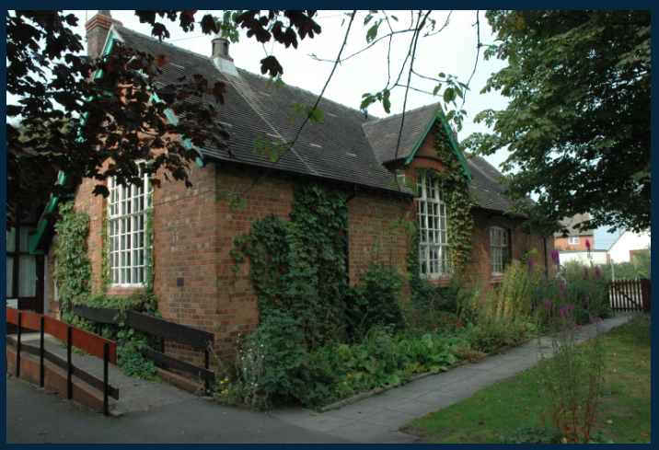
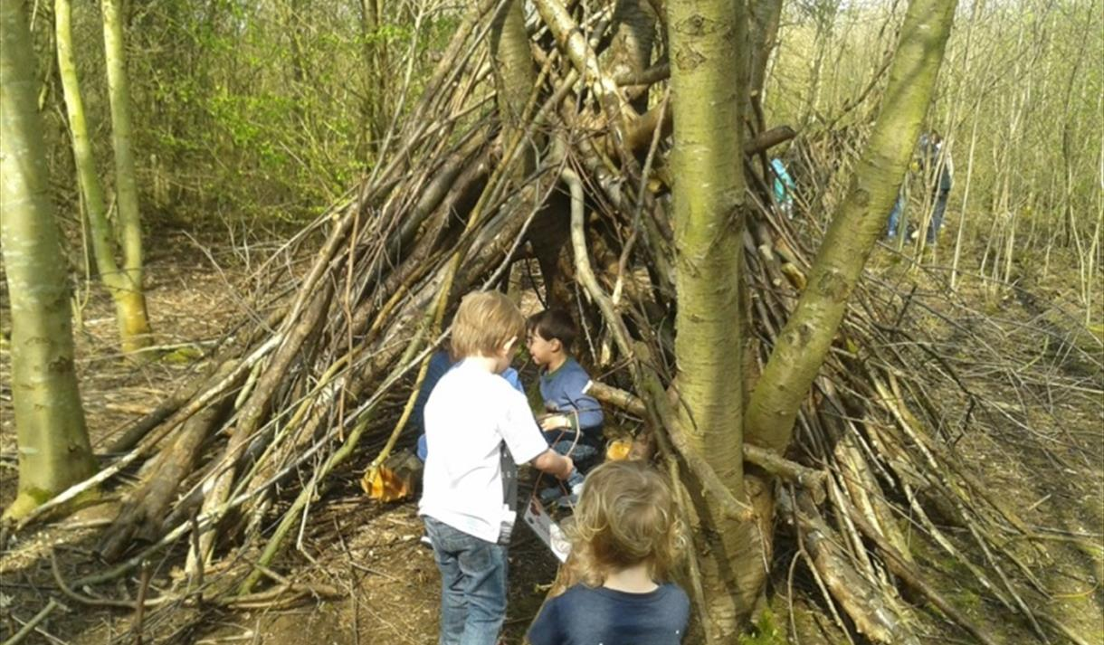
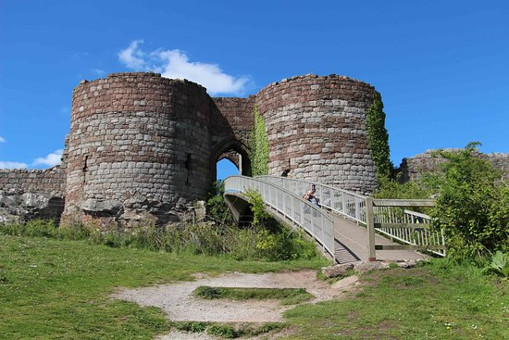

Slide 6
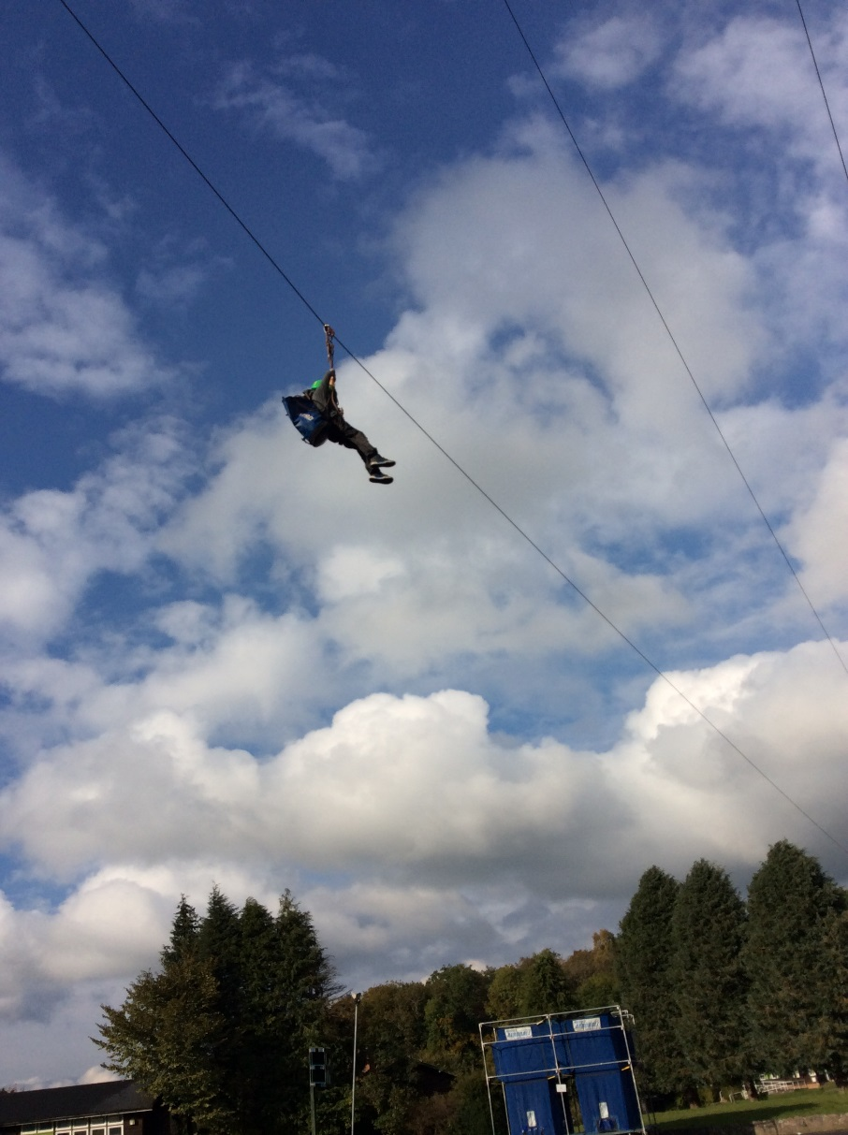
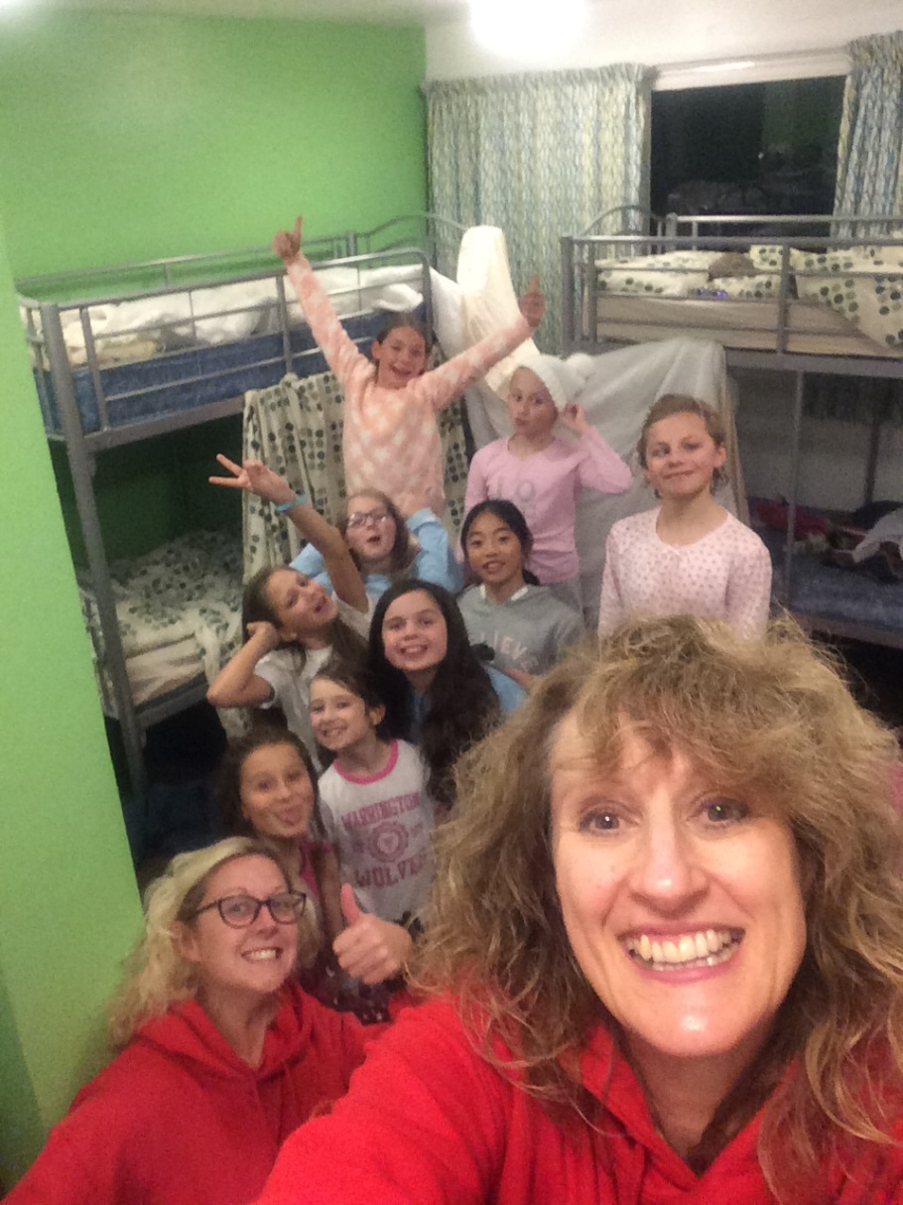
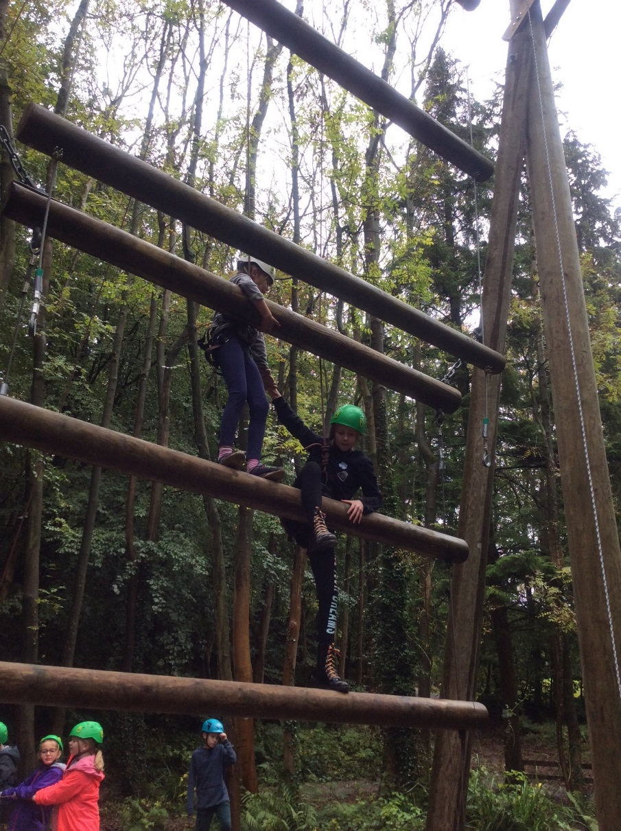
Kingswood Centre
Physical Education
Key stage 2
They should enjoy communicating, collaborating and competing with each other.
Take part in outdoor and adventurous activity challenges both individually and within a team

Slide 7
Arete Outdoor Centre
Geography
The national curriculum for geography aims to ensure that all pupils:
develop contextual knowledge of the location of globally significant places – both terrestrial and marine – including their defining physical and human characteristics and how these provide a geographical context for understanding the actions of processes
understand the processes that give rise to key physical and human geographical features of the world, how these are interdependent and how they bring about spatial variation and change over time
are competent in the geographical skills needed to:
collect, analyse and communicate with a range of data gathered through experiences of fieldwork that deepen their understanding of geographical processes
Physical Education
Key stage 2
They should enjoy communicating, collaborating and competing with each other.
Take part in outdoor and adventurous activity challenges both individually and within a team

Slide 9
Payment plans
The financial wellbeing of our families is a high priority when organising all trips.
To support payment for residential trips we offer a range of payment plans.
These include:
Parent Pay
Up front payments
Monthly payments
Regular payment structures e.g. 3 or 4 payments

Slide 10
Questions?

